Slide 1
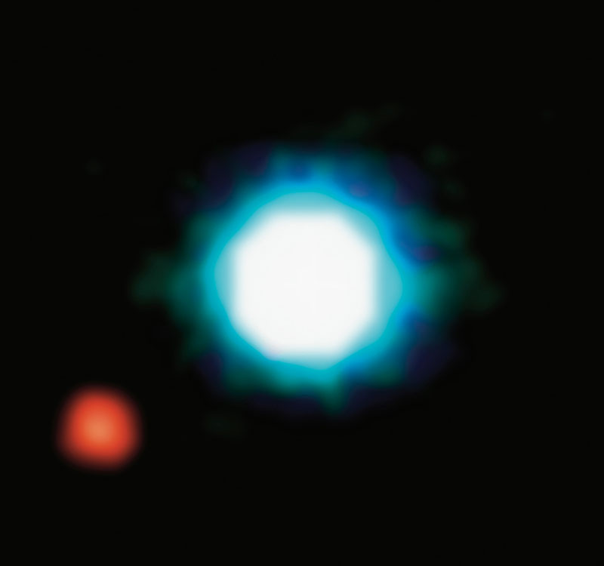
EXOPLANETS
Shall we start packing?
© NASA

Slide 2
EXOPLANETS
– Any planet beyond our solar system
2M1207
Brown dwarf
230 light-years from Earth
2M1207b
Jupiter-like planet
5x Jupiter’s size
Orbits at a distance 55x larger than the Earth to the Sun
© NASA
Notes:
An exoplanet is a planet beyond out solar system which is orbiting a star. They were first discovered in 1988, and ever since the number of new planets has increased steadily.
This is the first image captured from an exoplanet in 2007. This planet is 5 times bigger than Jupiter, and orbits at a distance 55 times larger than the distance from the earth to the sun.
It’s great to find more planets outside of our solar system, but…

Slide 3
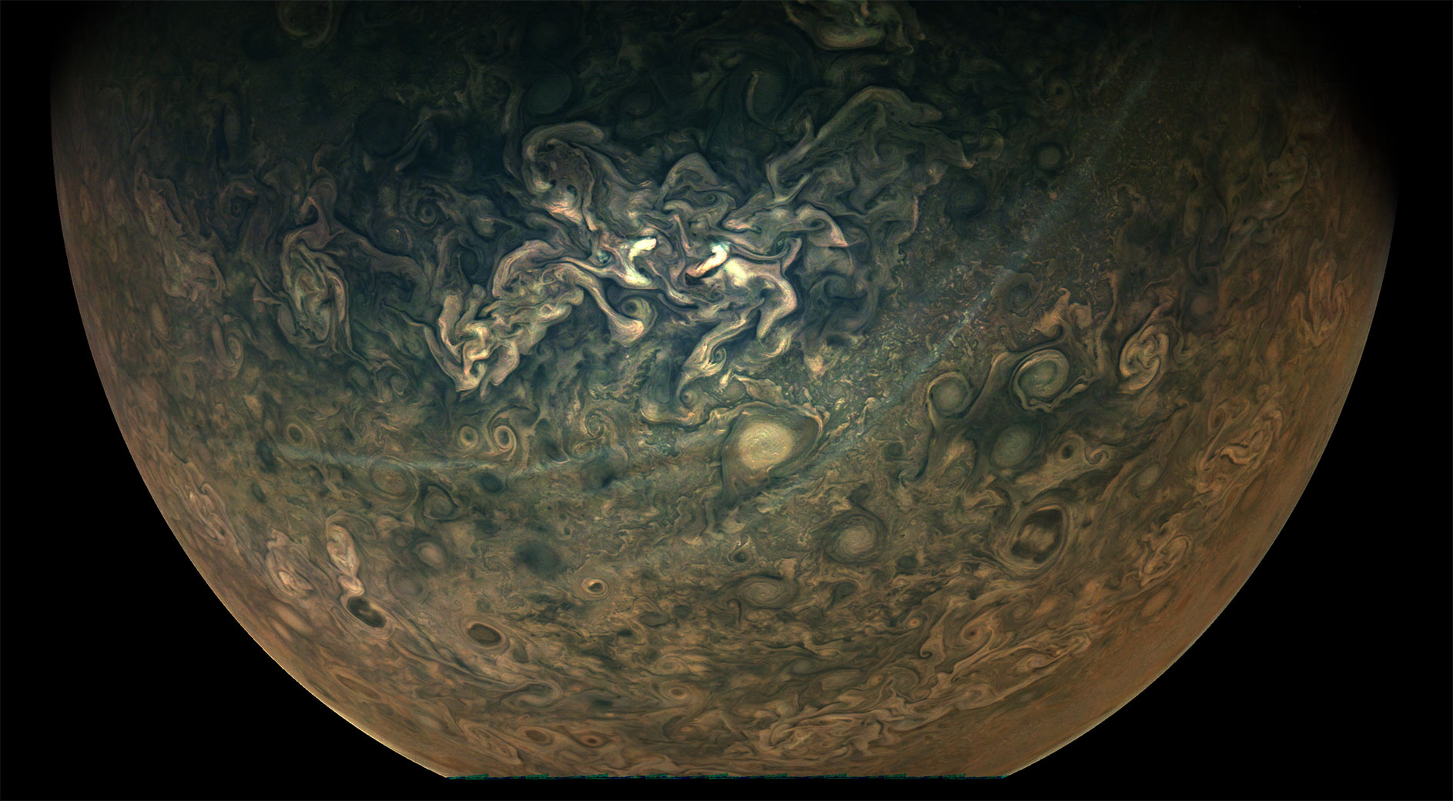
Is there any planet habitable?
Notes:
The question is:
IS THERE ANY PLANET HABITABLE?

Slide 4
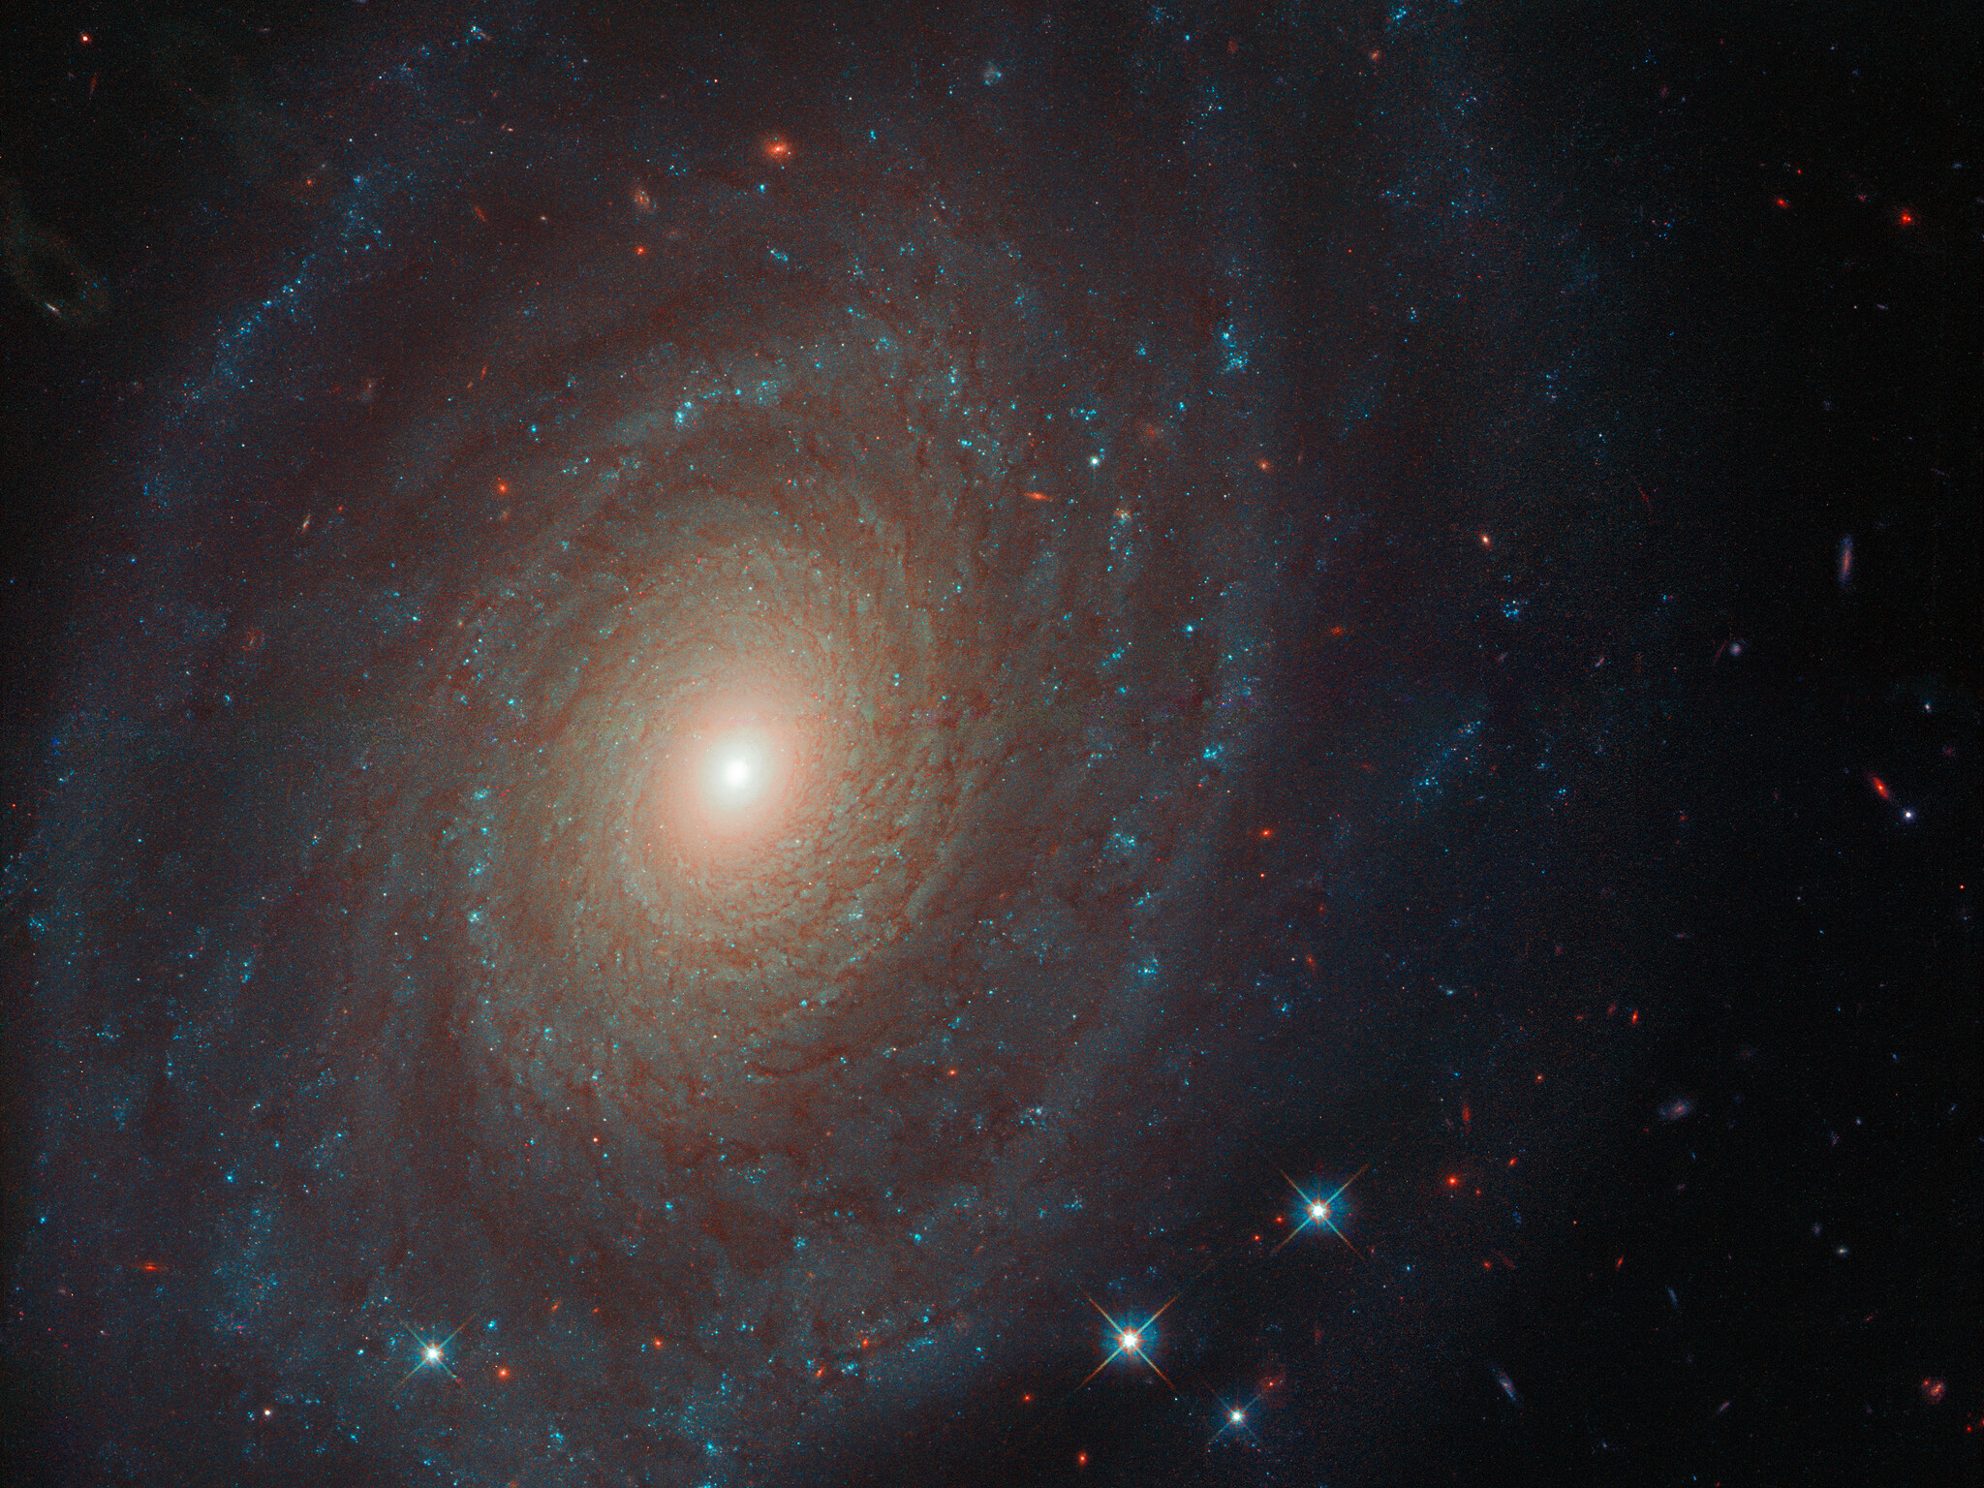
Before booking, you better check the offer…
Similar conditions to Earth:
Planet orbit
Mass of the star
Distance star-planet
Temperature
Atmosphere
Distance Earth-to-planet
Notes:
So what are the conditions that would make life possible in an exoplanet?
We have to look for similar conditions to Earth, and that means:
- The planet orbit around its star
- The mass of the star
- The distance from the star to the planet, which will determine the temperature of the planet
The presence of an atmosphere and its composition
We can approach this by looking at the data that has been collected so far

Slide 5
Before booking, you better check the offer…
Data acquisition:
NASA – Exoplanets API
The Extrasolar Planets Encyclopaedia (EU)
Web scraping for explanation of NASA information
Notes:
The total amount of discovered exoplanets is 4144, as reported by NASA. However, the EU portal for exoplanets reports 4247 planets.
We realized that there are names mismatches and *more planets* registered in EU. For example, GJ 273 e, which was discovered in 2019, is not reported by NASA. The difference might be related to the confirmation methods that vary between the agencies.
Here we present the data from NASA, which is generally considered the most reliable source of information from the space.
By removing the outliers, we observe that most of the planets orbit their host stars in less than 1000 days, but there are also planets that have an orbit period of 7000 days, which is equal to 19 years! Here we can see the earth for comparison.

Slide 6
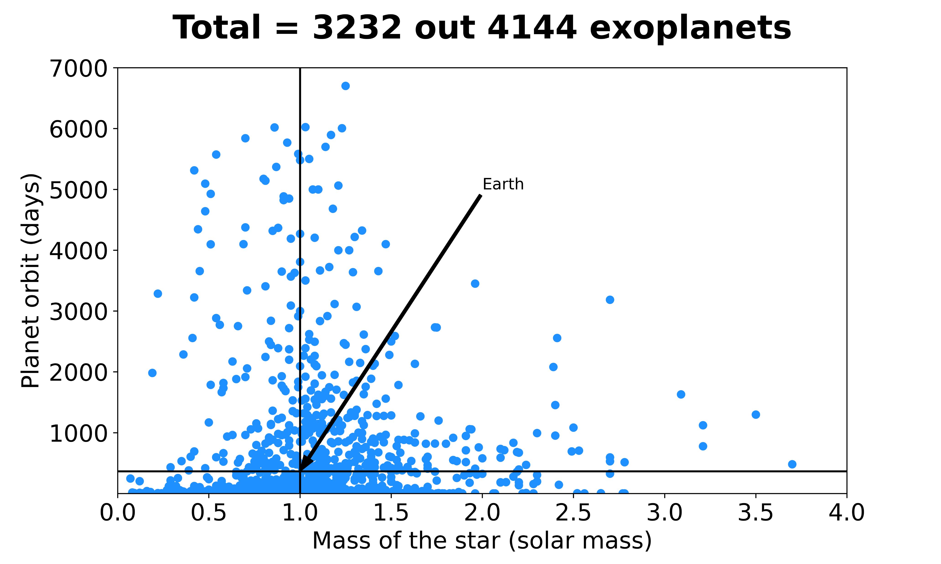
Before booking, you better check the offer…
Two approaches:
Solar mass/planet orbit
Temperature/distance
Notes:
The total amount of discovered exoplanets is 4144, as reported by NASA. However, the EU portal for exoplanets reports 4247 planets.
We realized that there are names mismatches and *more planets* registered in EU. For example, GJ 273 e, which was discovered in 2019, is not reported by NASA. The difference might be related to the confirmation methods that vary between the agencies.
Here we present the data from NASA, which is generally considered the most reliable source of information from the space.
By removing the outliers, we observe that most of the planets orbit their host stars in less than 1000 days, but there are also planets that have an orbit period of 7000 days, which is equal to 19 years! Here we can see the earth for comparison.

Slide 7
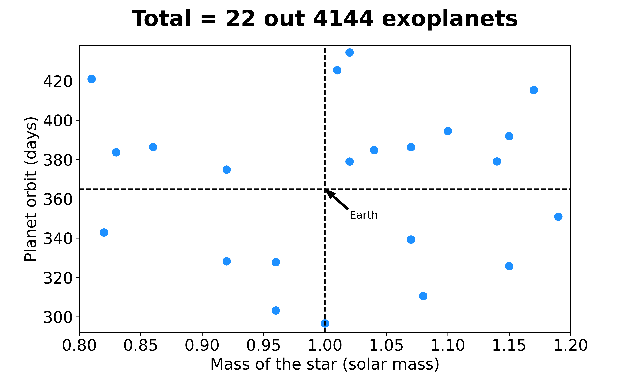
Seems like home!
Exoplanets matching possible conditions to Earth
Notes:
So out of those planets that have a planet orbit measured or calculated, we can narrow down the data to the planets with an orbit that lies within a range of +- 20% of Earth’s orbit. And narrowing down the same for the mass of the star, we get 22 planets of 4144.
So these are the planets that resemble the closest to the Earth in terms of the planet orbit and their relation to their respective star.

Slide 8
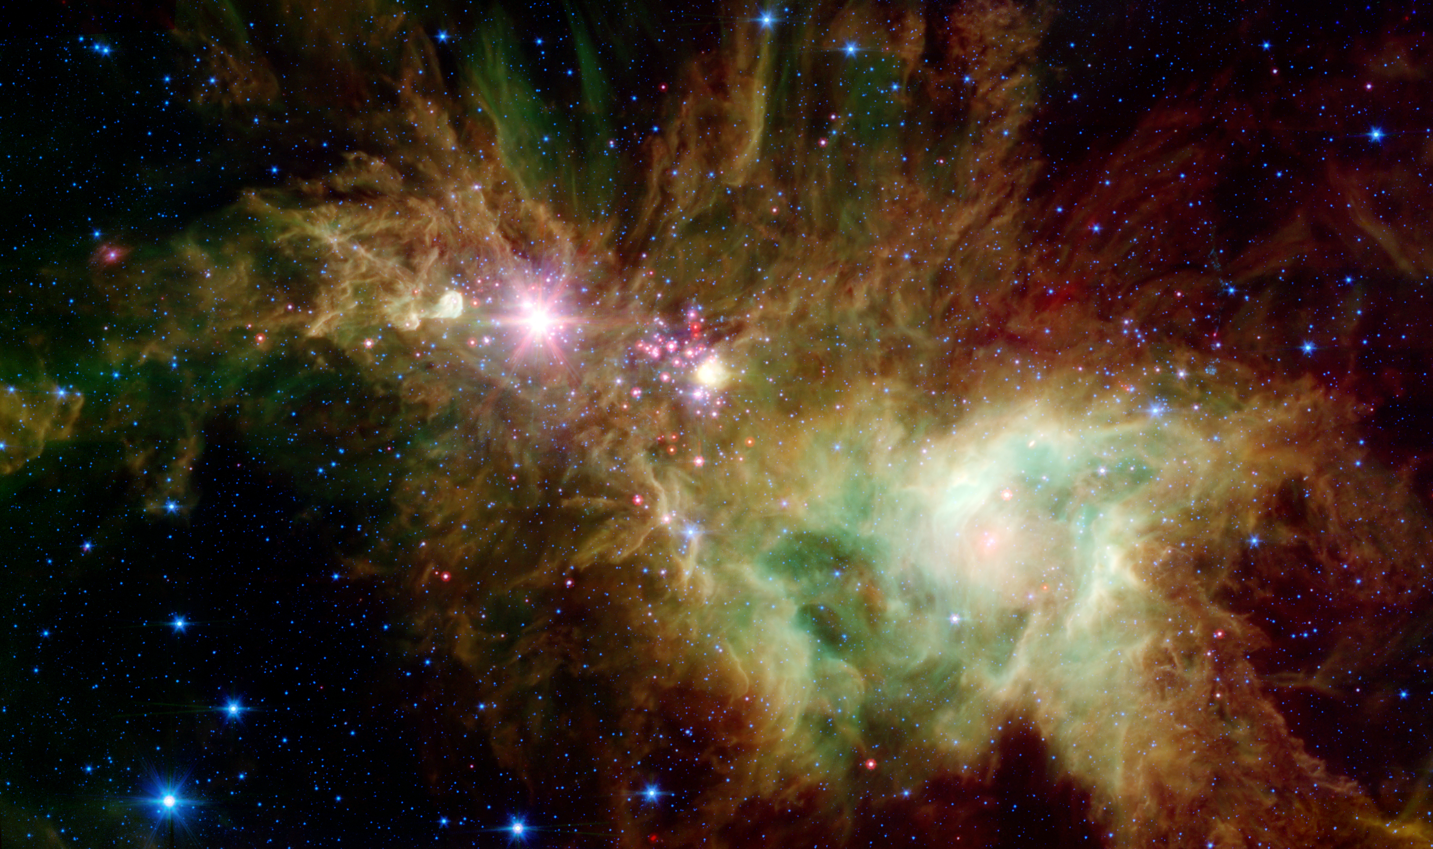
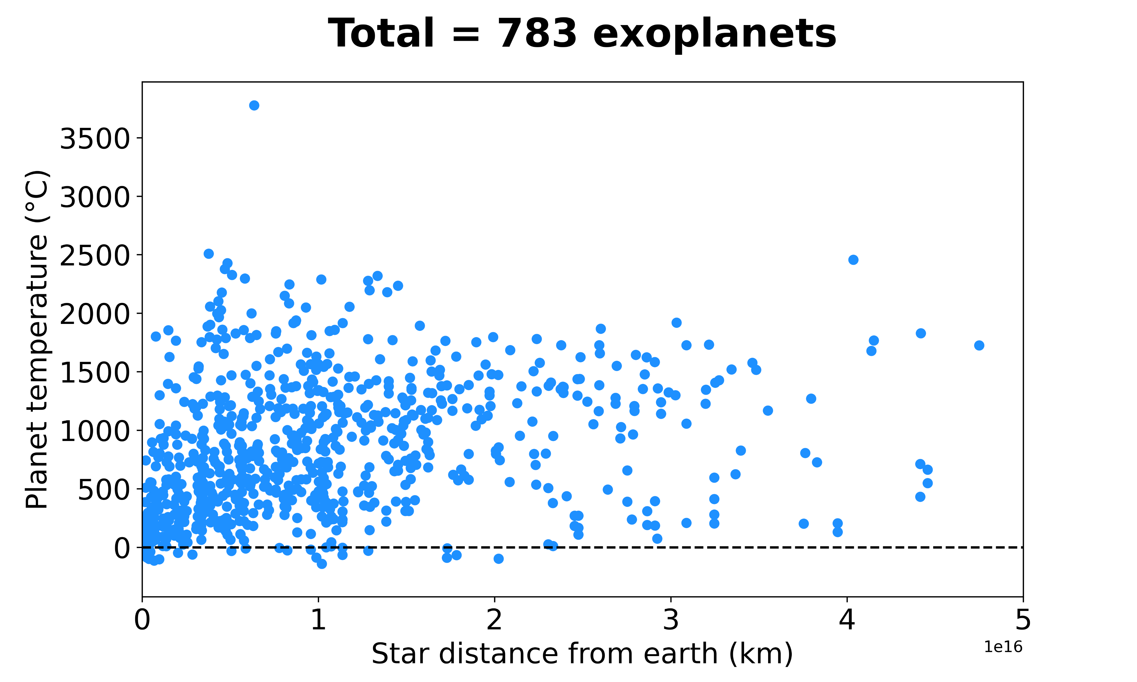
Tropical summer or cold winter?
Notes:
Now, the distance between the exoplanet and the star is directly related the temperature of the planet, which is an important parameter to allow the existence of life.
We found 783 planets for which their temperature has been measured or calculated.
We can see in this figure that the temperature varies greatly from -170 up to above 3500 °C. So for those who prefer a tropical weather, worry NOT, we’ve got you covered

Slide 9
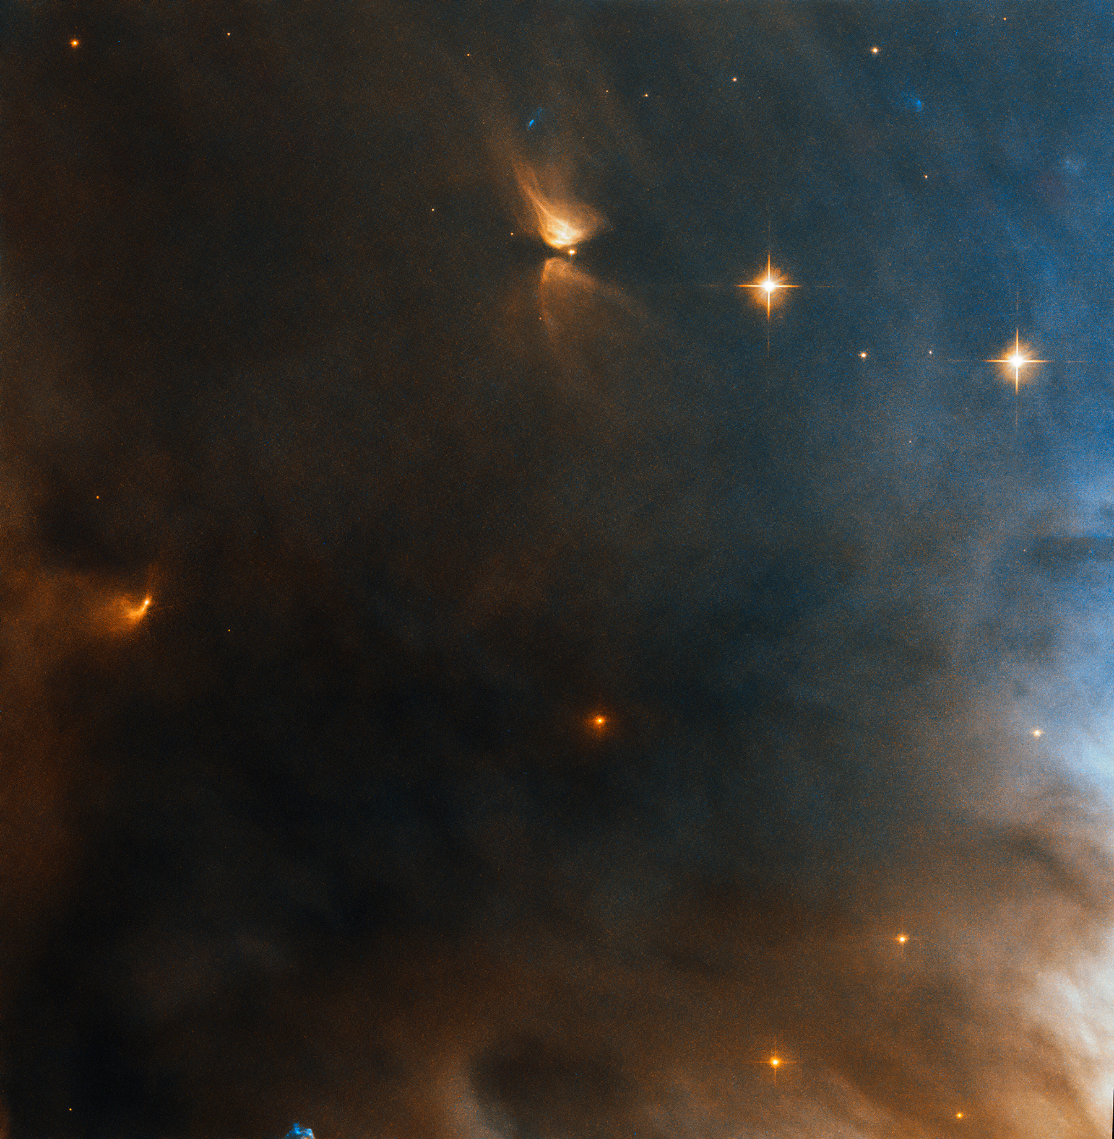
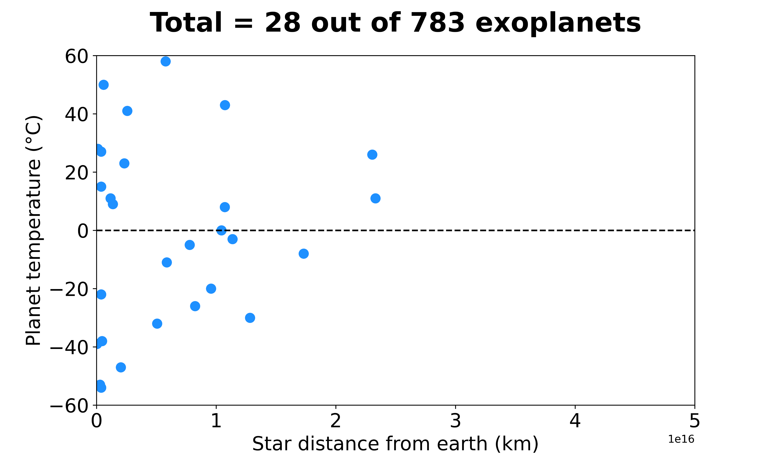
Getting cozier…
Notes:
All right, but on a more serious note, we can also narrow the data to a range of temperature that is closer to that of the earth.
So if we take a lower limit at -60 °C like we find in the Antartica to 60 °C that has been recorded in California, we find only 28 planets. Great!
Now the distance to these systems from earth tho it’s approx 1 million times greater the distance the voyager has traveled from earth, which is 18 billion km, so no matter what we choose, it’s gonna be a long trip!

Slide 10
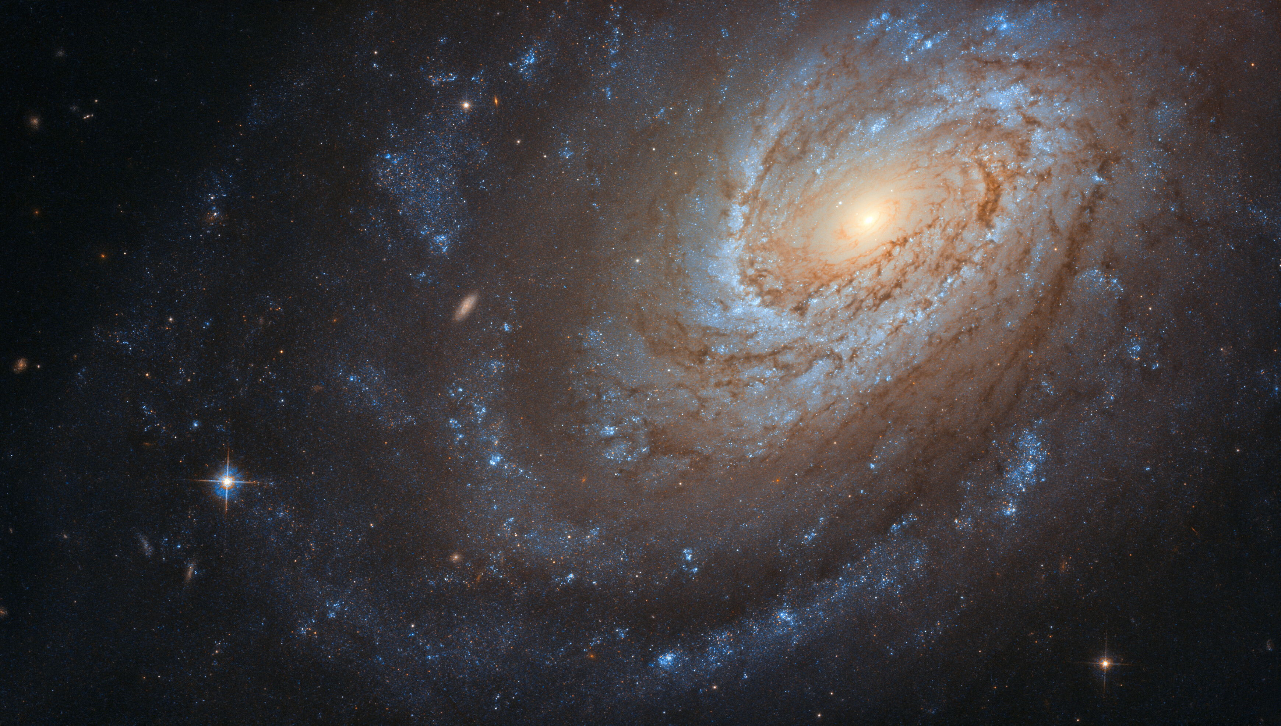
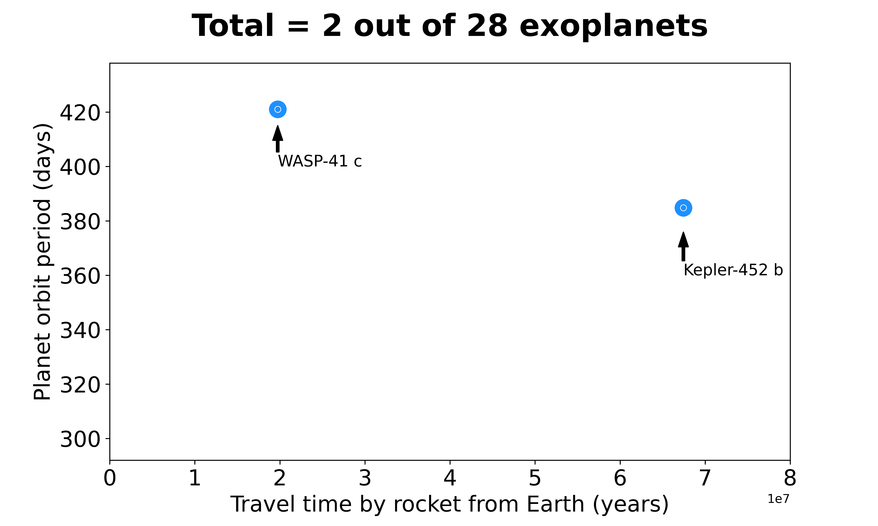
Packing already?
Well, not just yet!
Notes:
Now how do we narrow it down even more?
We can filter by the planet orbit so that we have those closely resembling the earth, and there you go, we find 2 planets.
WASP-41 c is 1000 times as heavy as earth, so it’s most likely a gas planet, thus inhabitable.
So, it seems we have a winner: Kepler 452 b. Indeed, this planet has been identified by NASA as the most earth-like planet so far. It has a temperature of -8 °C, so you better get your coats ready.
So are we ready to take the next flight to go there?
Well, not just yet. The time it would take to reach the planet by a rocket would be approx. 70 million years, so it may take a little longer before we can get there. So in the meantime, TAKE CARE OF YOUR PLANET.

